Slide 1
Department of Computer Science and Engineering Project Work Phase 1 +Seminar(17CSP78) 1st Review
API for Document Resizing, Validation and Verification
Batch No: 2020_CSE_15
Under the guidance of: | Bhavesh Bhansali | 1KS17CS016
Mrs. Vaneeta M | Ganesh Maudghalya H G | 1KS17CS025
Associate Professor | Karan Raghunath | 1KS17CS032
Dept of CSE, KSIT | P Ksihore | 1KS17CS051

Slide 2
Introduction
Technology has enabled us to upload and submit documents online at ease with computers, mobile phones, etc.
With this comfort there also comes the hassle of monitoring, adjusting size and dimensions of the document images(jpeg and png) and the clarity of the content in images requested by the websites.
Our service will help the website developers and the user to receive and upload images respectively without having to monitor the size(memory) and dimensions of images.

Slide 3
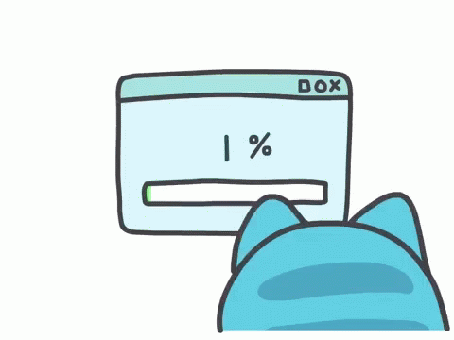
The product will be in the form of a API which will have different sections for different functions which are: Resizing, OCR, Document check(Validity of document based on format and layout) and Verification(Identity, authenticity).
The version of the API that will be developed will provide validation and verification for Aadhaar card, PAN card and Driving License. Further updates might include the implementation of verification of more documents.

Slide 4
Literature Survey
Author Kunal Relan [1] has proposed that Flask is a lightweight microframework for web applications built on top of Python, which provides an efficient framework for building web-based applications using the flexibility of Python and strong community support with the capability of scaling to serve millions of users.
Author Prateek Joshi [2] has proposed that When we are scaling by a non-integer value, we need to interpolate values appropriately, so that the quality of the image is maintained.
Authors Chirag Indravadanbhai Patel and Dharmendra Patel [3] have proposed that Optical character recognition (OCR) method has been used in converting printed text into editable text
Authors Satish Gojar, Rahul Joshi & Dhanashree Gaigaware [4] have proposed that Selenium IDE is an integrated development environment to build the test scripts

Slide 5
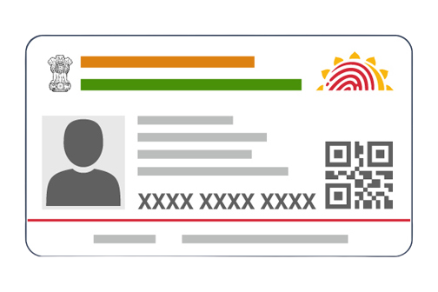


Problem Identification
People face problems while monitoring, adjusting the size and dimensions of the document images(jpeg and png) requested by the websites and hence are unable to use the online facilities with ease.
Problem Statement
To design and develop a API to Resize, Validate and Verify Images to assist in the process of uploading Documents for the user.
Scope
This API can be used by:
Any website that requires resizing for the images uploaded by the website users.
Websites that require validation, verification of authenticity and information of content of the document in the image.

Slide 6

Goals & Objectives
Successfully deploy a Web API to:
Resize Images based on size(memory) and dimensions
Extract information in the document using OCR
Check the validity of the document in the image uploaded
Verify the authenticity of the document

Slide 7
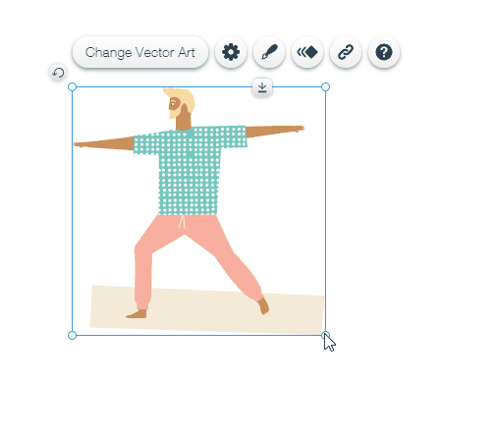
Methodology
The images are uploaded to a website by the user.
The website calls the API for the function that it needs to be performed.
The API starts with resizing the image according to the website’s requirement.
Based on the website’s requirement which is either or both validation of a document or/and verification of authenticity of the document in the image, respective functions are executed by the API.
The resized image is sent to the website developer with the details of the document if requested(OCR).

Slide 8

If the document in the image is not validated or verified when requested, an error code or message is sent to the website developer. The website can then prompt the user to upload a valid and proper image, again.
If the document is successfully validated and/or verified, a success code or message is sent to the developer.

Slide 9


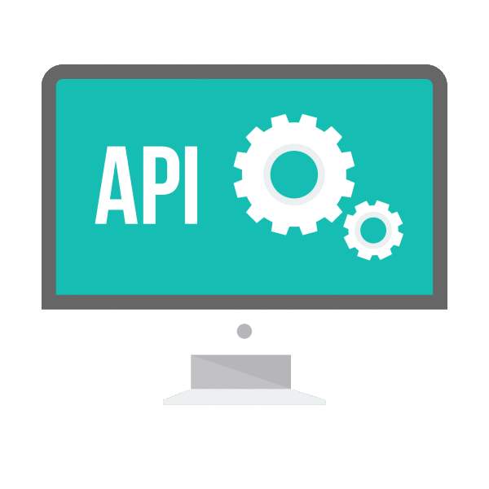

Block Diagram
UPLOAD
IMAGE(S)
USER
WEBSITE
ACTIVATE
API
RESIZE
OCR
VERIFY
DOCUMENT CHECK

Slide 10
Modules
Resizing:
OpenCV library will be used for resizing
The cv2.resize() function requires parameters of the size/dimensions of result image
OCR:
OCR will involve the usage of OpenCV, Pillow, Numpy and Pytesseract to extract the important information like Name, Date of Birth, Card Number, etc. from the document content in the image.

Slide 11
Validation:
Validation will include the usage of OCR information extracted and the checking of the validity of the document (whether the right document image is uploaded in the right field or not).
Verification:
Verification of Aadhar card is done by using https://resident.uidai.gov.in/verify website (Web Scraping) which verifies a valid Aadhar number by prompting Green tick mark
For PAN card, we’ll use https://www.incometaxindiaefiling.gov.in/ to check if the PAN number exists.

Slide 12
Expected Outcomes
Successful resizing of images
Successful validation of document in images
Successful verification of authenticity of the document in images
Successful retrieval of information of the document in the images by OCR.
Contribution To Society
Eases the discomfort of users, having to monitor, adjust the size and dimensions of the document images(jpeg and png) requested by the websites.
Helps websites with validation of document and verification of authenticity of the document uploaded by user.

Slide 13
References
[1] K. Relan, (Book) “Building REST APIs with Flask: Create Python Web Services with MySQL” https://doi.org/10.1007/978-1-4842-5022-8_1 2019, ISBN-13 (pbk): 978-1-4842-5021-1 ISBN-13 (electronic): 978- 1- 4842-5022-8, APRESS
[2] “OpenCV with Python By Example” Book by Prateek Joshi Originally published: 2015
[3] Chirag Indravadanbhai Patel, Dharmendra Patel, “Optical Character Recognition by Open source OCR Tool Tesseract: A Case Study” 2012
[4] Satish Gojar, Rahul Joshi & Dhanashree Gaigaware, “Analysis and Design of Selenium WebDriver Automation Testing Framework”, 2015
[5] Alejandra Castelblanco, Jesus Solano, Christian Lopez, Esteban Rivera, Lizzy Tengana, and Mart´ınOchoa, “Machine Learning Techniques for Identity Document Verification in Uncontrolled Environments: A Case Study”, 2020
[6] Miguel Grinberg, (Book) “Flask Web Development”, Printed in the United States of America. Published by O’Reilly Media, Inc., 1005, Gravenstein Highway North, Sebastopol, CA 95472. 2018

Slide 14


